Slide 1
Automatic Braking System
By: Kefil Tonouewa & Ravyn Dickinson
Professor: Stanley Yung-Ping Chien
ECE 47100

Slide 2
Project Description
Modeling an automatic braking system using an ultrasonic sensor, a potentiometer, LCD and a stepper motor.
Ultrasonic sensor will be used to sense the distance between the car and an obstacle. If the distance is lower than a certain amount, the stepper motor will come to an automatic complete stop; otherwise follow table below.
Potentiometer Value | Stepper Motor Speed
10K | Low
5K | Medium
0K | Maximum
Notes:
;

Slide 3
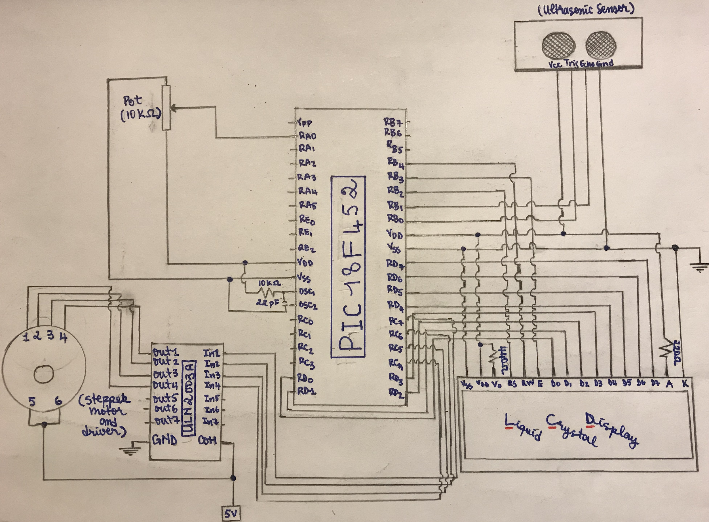
Hardware Schematic Program
Notes:
Too long - 1min

Slide 4
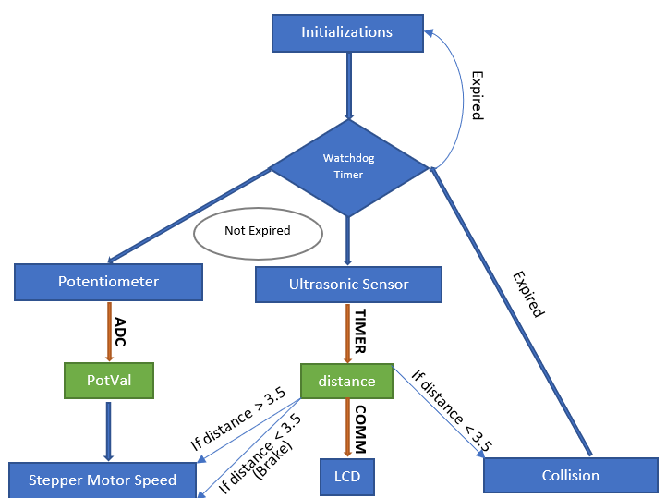
Software Block Diagram
Notes:
Too long - 1min 25 sec

Slide 5
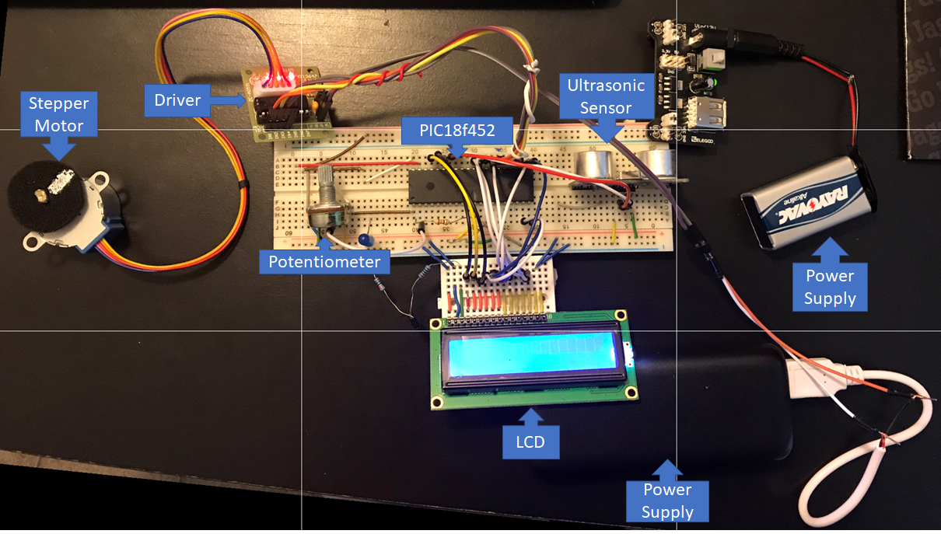
Final Product

Slide 6
Conclusion
Lessons Learned include:
how to correctly wire components together in a circuit
understanding PIC programming
acquiring knowledge on how to configure peripherals
the importance of studying documentation while programming microcontrollers

Slide 7
THANK YOU

